Slide 1
Azure Fundamentals
Cloud Concepts – Principles of Cloud Computing, Azure Data+AI and Core Cloud Services
Milliman TechForum 2021
MARCH 22, 2021 Version 1.0

Slide 2
Azure Fundamentals – Intro 1
Milliman TechForum
2021-MARCH-22
Notes:
31 questions, 90 min
Governance:
Identity:

Slide 3








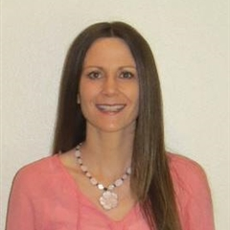

Your Microsoft Team for Milliman
“KJ” Jones
Srikanth Matcha
Patrick Link
Dan Davis
Daniel Gres
Account Executive
Azure Infra Specialist
Data/AI Specialist
Partner Manager
Account Technology Strategist
Mike Lee
Pushker Sahai
Megan Pietrzykowski
Isaac Roitman
Cloud Architect Apps & Infra
Cloud Architect Data & AI
Customer Success Acct Manager
Cloud Architect AppDev & Security
(assisting today)

Slide 4
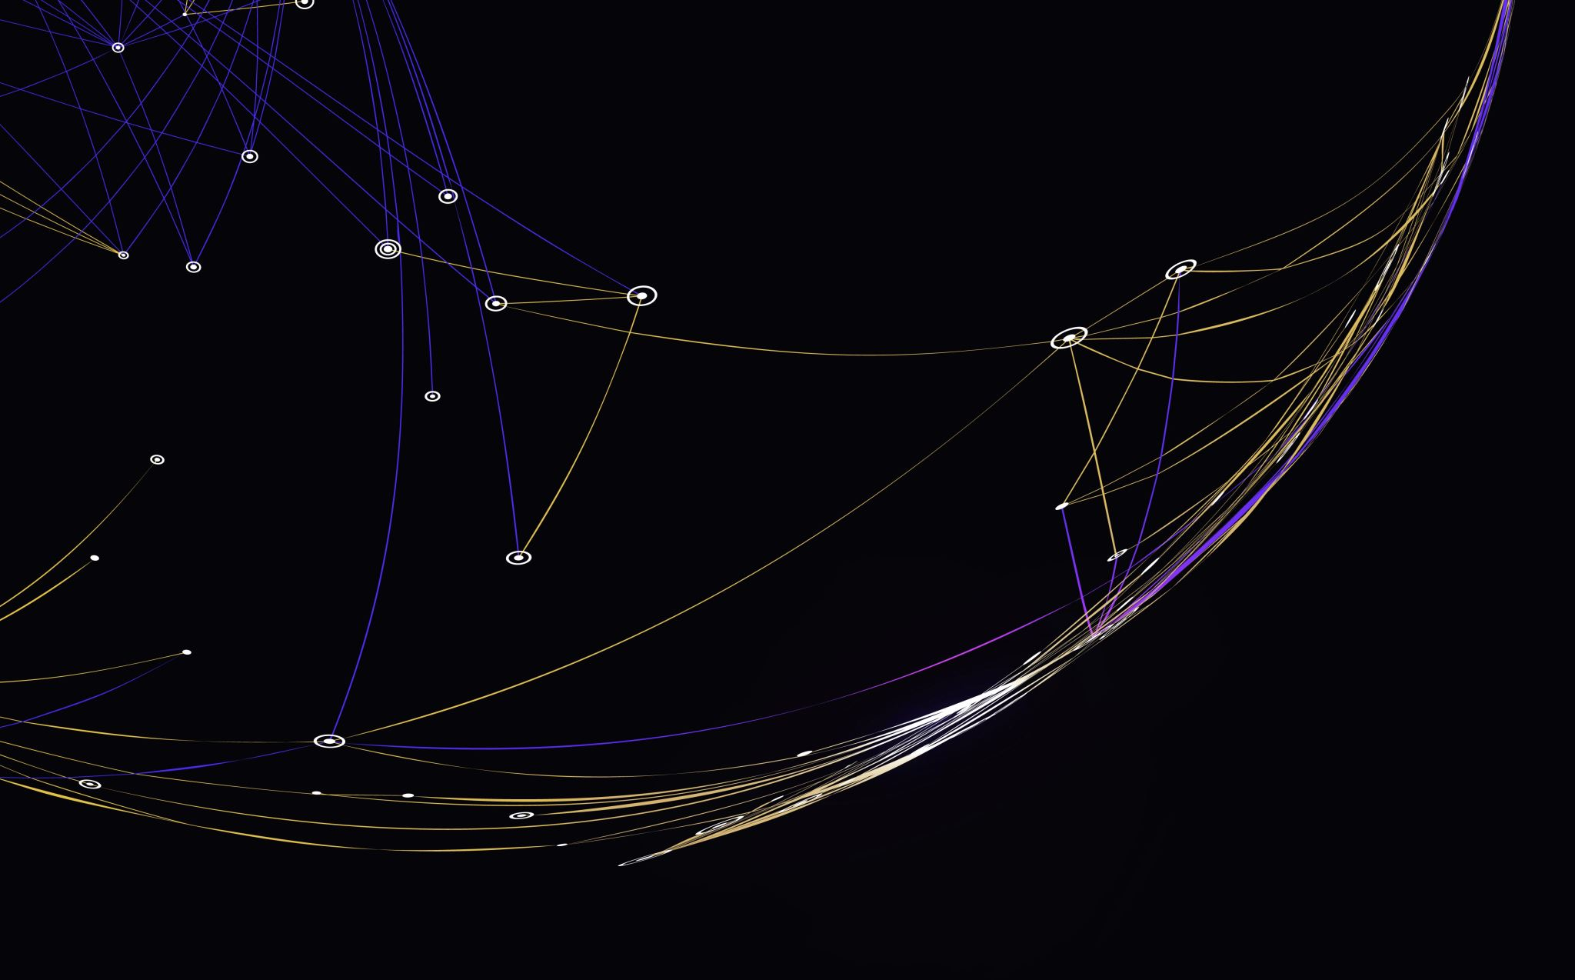
MICROSOFT TEAM FOR MILLIMAN
Kenneth (KJ) Jones KJ.Jones@microsoft.com, Account Executive (all Microsoft Products & Services)
Daniel Gres danielgres@microsoft.com, Account Technology Strategist (Maximize your Microsoft investments and build your technology strategy
Mike Lee Lee.Mike@microsoft.com, Azure Cloud Solution Architect (Azure Infra and Apps)
Shivashanker Bitla shbitla@microsoft.com, Principal Data Architect (Data/Analytics, Databricks, SQl, CosmosDb)
Pushker Sahai Pushker.Sahai@microsoft.com, AI Architect (Cognitive Services, ML)
Srikanth Matcha Srikanth.Matcha@microsoft.com, Azure Infra Specialist(Azure Infra, Windows Server, Sys Center)
Patrick Link Patrick.Link@microsoft.com, Data/AI Specialist (all things Data, on prem SQL)
Brian Keyes bkeyes@microsoft.com, DevOps Specialist(App Dev, GH, Containers)
Martha Diaz Martha.Diaz@microsoft.com, Biz Apps Specialist (Dynamics, Power Plat)
Mike Eldridge mikeld@microsoft.com, Modern Workplace Specialist (Desktop, M365, EMS)
Tonya Johnson Tonya.Johnson@microsoft.com , Security Specialist (EMS, Azure Security, Compliance)
Support – open ticket through Azure portal first. Escalations to Megan Pietrzykowski Megan.Pietrzykowski@microsoft.com, or Sanjeev Gogna Sanjeev.Gogna@microsoft.com(LTS/MedInsight)

Slide 5
Introductions
Presenter 1
Title
Presenter 2
Title
Presenter 3
Title
Presenter 4
Title
Presenter 6
Title

Slide 6
Customer Specific intro Topics
Insert Slides Covering:
Customer specific learning management system links.
Survey information
Guidance on study group format

Slide 7

Why is today's session important?
Learn Azure Fundamentals and Cloud Concepts
Know the basics of various solutions available in Azure
Learn how the Azure building blocks work together
Discover ways to manage and govern cloud compliance
Learn how cognitive services can be easily leveraged by applications
Feel free to raise your hand during Q&A or post questions in the chat!

Slide 8
Agenda
Azure Fundamentals
Cloud Concepts – Principles of Cloud Computing
Core Cloud Services – Intro to Azure

Slide 9
Azure Fundamentals Certification and the AZ-900 Exam

Slide 10
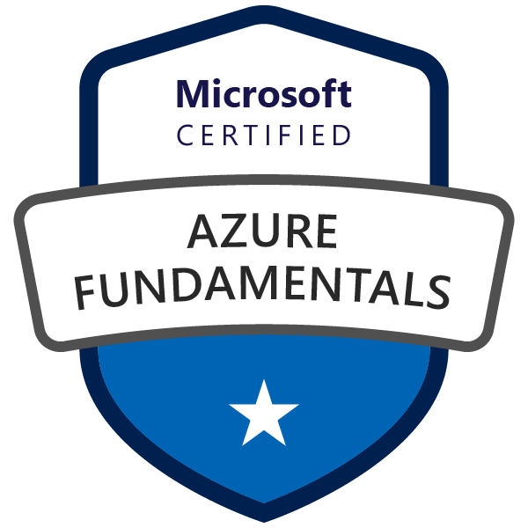
Microsoft Certified – Azure Fundamentals
Goal: Prove that you understand cloud concepts, core Azure Services, Azure pricing and support, the fundamentals of cloud security, privacy, compliance and trust.
Value: The knowledge gained by acquiring this certification will provide a valuable foundation for working with the platform and continuing on to more advanced role based Azure certifications.

Slide 11

Azure Role-based Certifications
Fundamentals
Associate
Expert
Azure Administrator Associate
Exam AZ-103
Azure DevOps Engineer Expert
Azure Developer Associate
Exams AZ-400
Exam AZ-203
Azure Security Engineer Associate
Azure Fundamentals
Exam AZ-500
Exam AZ-900
Azure Solutions Architect Expert
Azure AI Engineer Associate
Exams AZ-300 + AZ-301
Exam AI-100
Azure Data Engineer Associate
Exam DP-200
More roles to come ...
Azure Certification Exams: aka.ms/ExamsAzure

Slide 12
Exam Blueprint ( AZ-900 )
Study areas | Weights
Understanding cloud concepts | 15-20%
Understanding core Azure services | 30-35%
Understand security, privacy, compliance, and trust | 30-35%
Understand Azure pricing and support | 25-30%
Percentages indicate the relative weight of each area on the exam.
The higher the percentage, the more questions you are likely to see in that area.
Absolutely an accurate representation of what questions will show up.

Slide 13
Skills Measured – Understand Cloud Concepts (15-20%)
Describe the benefits and considerations of using cloud services
understand terms such as High Availability, Scalability, Elasticity, Agility, Fault Tolerance, and Disaster Recovery
understand the principles of economies of scale
understand the differences between Capital Expenditure (CapEx) and Operational Expenditure (OpEx)
understand the consumption-based model
Describe the differences between Infrastructure-as-a-Service (IaaS), Platform-as-a-Service (PaaS) and Software-as-a-Service (SaaS)
describe Infrastructure-as-a-Service (IaaS)
describe Platform-as-a-Service (PaaS)
describe Software-as-a-Service (SaaS)
compare and contrast the three different service types
Describe the differences between Public, Private and Hybrid cloud models
describe Public cloud
describe Private cloud
describe Hybrid cloud
compare and contrast the three different cloud models

Slide 14
Azure Fundamentals Learning Path - Prework
Cloud Concepts – Principles of Cloud Computing
Core Cloud Services – Introduction to Azure

Slide 15
Cloud Concepts Principles of Cloud Computing

Slide 16
What is Cloud Computing?
From NIST (National Institute of Standards & Technology):
“Cloud computing is a model for enabling ubiquitous, convenient, on-demand network access to a shared pool of configurable computing resources (e.g., networks, servers, storage, applications, and services) that can be rapidly provisioned and released with minimal management effort or service provider interaction.”
https://nvlpubs.nist.gov/nistpubs/Legacy/SP/nistspecialpublication800-145.pdf

Slide 17
Benefits of Cloud Computing
Functionality
Scalability
Elasticity
Agility
High availability
Disaster recovery
Global reach
Security

Slide 18
Azure covers 91 compliance offerings
Industry
Regional
US Gov
Global
Azure has the deepest and most comprehensive compliance coverage in the industry
ISO 27001:2013
ISO 27017:2015
ISO 27018:2014
ISO 22301:2012
ISO 9001:2015
ISO 20000-1:2011
SOC 1 Type 2
SOC 2 Type 2
SOC 3
CIS Benchmark
CSA STAR Certification
CSA STAR Attestation
CSA STAR self-assessment
WCAG 2.0 (ISO 40500:2012)
FedRAMP high
FedRAMP moderate
EAR
ITAR
DoD DISA SRG Level 5
DoD DISA SRG Level 4
DoD DISA SRG Level 2
DFARS
DoE 10 CFR Part 810
NIST SP 800-171
NIST CSF
Section 508 VPATs
FIPS 140-2
CJIS
IRS 1075
CNSSI 1253
PCI DSS Level 1
GLBA (US)
FFIEC (US)
Shared assessments (US)
SEC 17a-4 (US)
CFTC 1.31 (US)
FINRA 4511 (US)
SOX (US)
23 NYCRR 500 (US)
OSFI (Canada)
FCA + PRA (UK)
APRA (Australia)
FINMA (Switzerland)
FSA (Denmark)
RBI + IRDAI (India)
MAS + ABS (Singapore)
NBB + FSMA (Belgium)
AFM + DNB (Netherlands)
AMF + ACPR (France)
KNF (Poland)
European Banking Authority (EBA)
FISC (Japan)
HIPAA BAA (US)
HITRUST certification
GxP (FDA 21 CFR Part 11)
MARS-E (US)
NHS IG Toolkit (UK)
NEN 7510:2011 (Netherlands)
FERPA (US)
CDSA
MPAA (US)
FACT (UK)
DPP (UK)
TISAX (Germany)
Argentina PDPA
Australia IRAP Unclassified
Australia IRAP PROTECTED
Canada Privacy Laws
China GB 18030:2005
China DJCP (MLPS) Level 3
China TRUCS/CCCPPF
EU EN 301 549
EU ENISA IAF
EU model clauses
EU—US privacy shield
GDPR
Germany C5
Germany IT— Grundschutz workbook
India MeitY
Japan CS mark gold
Japan my number act
Netherlands BIR 2012
New Zealand Gov CIO Framework
Singapore MTCS Level 3
Spain ENS High
Spain DPA
UK cyber essentials plus
UK G-Cloud
UK PASF
Korea K-ISMS
France HDS
https://aka.ms/AzureCompliance

Slide 19
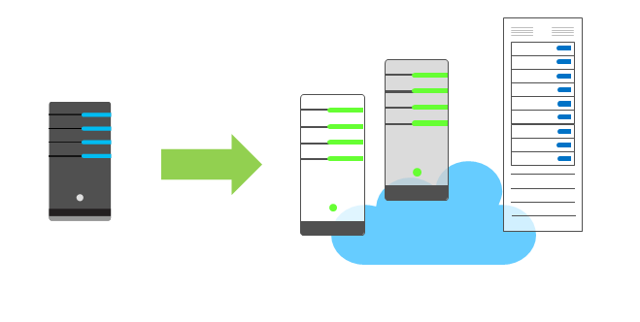
Economies of scale
The concept of economies of scale is the ability to do things less expensively and more efficiently when operating at a larger scale in comparison to operating at a smaller scale.
Cloud providers such as Microsoft, Google, and Amazon Web Services (AWS) are very large businesses, and thus can leverage the benefits of economies of scale and then pass those benefits on to their customers.

Slide 20
CapEx vs. OpEx
Capital Expenditure (CapEx) is the spending of money on physical infrastructure up front, and then deducting that expense from your tax bill over time. CapEx is an upfront cost which has a value that reduces over time.
Operational Expenditure (OpEx) is spending money on services or products and being billed for them immediately. You can deduct this expense from your tax bill in the same year. There is no upfront cost, you pay for a service or product as you use it.

Slide 21
Cloud Service Models
On-premises
(Private Cloud)
Infrastructure
(as a Service)
Platform
(as a Service)
Software
(as a Service)
Applications
Applications
You manage
Applications
Applications
Data
Data
Data
Data
You manage
Runtime
Runtime
Runtime
Runtime
Managed by vendor
You manage
Middleware
Middleware
Middleware
Middleware
O/S
Managed by vendor
O/S
O/S
O/S
Virtualization
Virtualization
Managed by vendor
Virtualization
Virtualization
Servers
Servers
Servers
Servers
Storage
Storage
Storage
Storage
Networking
Networking
Networking
Networking

Slide 22
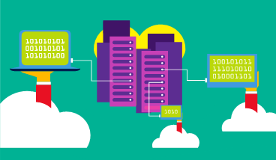
Cloud Deployment Models - Public cloud
A public cloud is owned by a cloud services provider (also known as a hosting provider). It provides resources and services to multiple organizations and users who connect to the cloud service via a secure network connection, typically over the internet

Slide 23
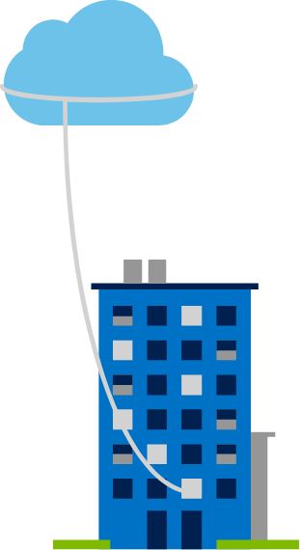
Cloud Deployment Models - Private cloud
A private cloud is owned and operated by the organization that uses the resources from that cloud. They create a cloud environment in their own datacenter and provide self-service access to compute resources to users within their organization. The organization remains the owner, entirely responsible for the operation of the services they provide.

Slide 24
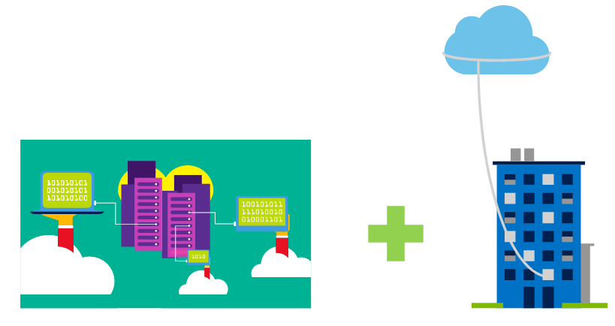
Hybrid cloud
Cloud Deployment Models
A hybrid cloud combines both public and private clouds, allowing you to run your applications in the most appropriate location

Slide 25
Cloud model comparison
Public cloud:
No CapEx. You don’t have to buy a new server to scale up.
Agility. Applications can be made accessible quickly, and deprovisioned whenever needed.
Consumption-based model. Organizations pay only for what they use, and operate under an OpEx model.
Private cloud:
Control. Organizations have complete control over resources.
Security. Organizations have complete control over security.
Hybrid cloud:
Flexibility. The most flexible scenario. With a hybrid cloud setup, an organization can determine whether to run their applications in a private cloud or in a public cloud.
Compliance. Organizations maintain the ability to comply with strict security, compliance, or legal requirements as needed.

Slide 26
Review Question 1
Q: What would be viewed as benefits of using public cloud services?

Slide 27
Review Question 1
Q: What would be viewed as benefits of using public cloud services? A: To name a few: Elasticity: As your workload changes due to a spike or drop in demand, a cloud computing system can compensate by automatically adding or removing resources.
Global Reach: Cloud providers have fully redundant datacenters located in various regions all over the globe. This gives you a local presence close to your customers to give them the best response time possible no matter where in the world they are.
Agility: Cloud-based resources can be deployed and configured quickly as your application requirements change. Applications can be made accessible quickly, and deprovisioned whenever needed.
Notes:
Security: Cloud providers offer a broad set of policies, technologies, controls, and expert technical skills that can provide better security than most organizations can otherwise achieve. The result is strengthened security, which helps to protect data, apps, and infrastructure from potential threats.

Slide 28
Review Question 2
Q: Which cloud delivery model provides the greatest degree of flexibility?

Slide 29
Review Question 2
Q: Which cloud delivery model provides the greatest degree of flexibility? A: Generally a hybrid cloud computing model provides the greatest deal of flexibility. In this case you’re able to benefit from the advantages of both private and public cloud computing.

Slide 30
Review Question 3
Q: You're developing an application and want to focus on building, testing, and deploying. You don't want to worry about managing the underlying hardware or software. Which cloud service model is best for you?

Slide 31
Review Question 3
Q: You're developing an application and want to focus on building, testing, and deploying. You don't want to worry about managing the underlying hardware or software. Which cloud service model is best for you?
A: Platform as a Service or PaaS would be the best service type for you. With these types of services the cloud provider takes care of the services underlying software and hardware. SaaS would not be appropriate here as you’re building your own application.
Notes:
PaaS: This cloud service model is a managed hosting environment.
The cloud provider manages the virtual machines and networking resources, and the cloud tenant deploys their applications into the managed hosting environment.
For example, Azure App Services provides a managed hosting environment where developers can upload their web applications without having to deal with the physical hardware and software requirements.

Slide 32
Review Question 4
Q: Which solution represents a hybrid computing model?
An Azure Function that executes on a timer and checks configuration of your Azure resources.
A mobile application that connects to Azure DB for PostgreSQL.
An on premises web application that connects to Azure SQL db.

Slide 33
Review Question 4
Q: Which solution represents a hybrid computing model?
An Azure Function that executes on a timer and checks configuration of your Azure resources.
A mobile application that connects to Azure DB for PostgreSQL.
An on premises web application that connects to Azure SQL db.

Slide 34
Core Cloud Services Intro to Azure

Slide 35
Skills Measured – Understand Core Azure Services (30-35%)
Understand the core Azure architectural components
describe Regions
describe Availability Zones
describe Resource Groups
describe Azure Resource manager
describe the benefits and usage of core Azure architectural components
Describe some of the core products available in Azure
describe products available for Compute such as Virtual Machines, Virtual Machine Scale Sets, App Service and Functions
describe products available for Networking such as Virtual Network, Load Balancer, VPN Gateway, Application Gateway and Content Delivery Network
describe products available for Storage such as Blob Storage, Disk Storage, File Storage, and Archive Storage
describe products available for Databases such as CosmosDB, Azure SQL Database, Azure Database Migration service, and Azure SQL Data Warehouse
describe the Azure Marketplace and its usage scenarios
Describe some of the solutions available on Azure
describe Internet of Things (IoT) and products that are available for IoT on Azure such as IoT Fundamentals, IoT Hub and IoT Central
describe Big Data and Analytics and products that are available for Big Data and Analytics such as SQL Data Warehouse, HDInsight and Data Lake Analytics
describe Artificial Intelligence (AI) and products that are available for AI such as Azure Machine Learning Service and Studio
describe Serverless computing and Azure products that are available for serverless computing such as Azure Functions, Logic Apps and App grid
describe the benefits and outcomes of using Azure solutions
Understand Azure management tools
understand Azure tools such as Azure CLI, PowerShell, and the Azure Portal
understand Azure Advisor

Slide 36
Azure Service Categories
AI + Machine Learning
Management and Governance
Analytics
Media
Compute
Microsoft Azure Stack
Containers
Migration
Databases
Mobile
Developer Tools
Networking
DevOps
Security
Identity
Storage
Integration
Web
Internet of Things
Microsoft Game Development

Slide 37
Services - Compute
AI + Machine Learning
Management and Governance
Compute
Access cloud compute capacity and scale on demand—and only pay for the resources you use
Analytics
Media
Compute
Microsoft Azure Stack
Virtual Machines Provision Windows and Linux virtual machines in seconds | Virtual Machine Scale Sets Manage and scale up to thousands of Linux and Windows virtual machines
Azure Kubernetes Service (AKS) Simplify the deployment, management, and operations of Kubernetes | Functions Process events with serverless code
Service Fabric Develop microservices and orchestrate containers on Windows or Linux | App Service Quickly create powerful cloud apps for web and mobile
Container Instances Easily run containers on Azure without managing servers | Batch Cloud-scale job scheduling and compute management
Azure Batch AI Easily experiment and train your deep learning and AI models in parallel at scale
Containers
Migration
Databases
Mobile
Developer Tools
Networking
DevOps
Security
Identity
Storage
Integration
Web
Internet of Things
Microsoft Game Development
* Preview Services
http://azureplatform.azurewebsites.net/

Slide 38
Services - Networking
AI + Machine Learning
Management and Governance
Networking
Connect cloud and on-premises infrastructure and services to provide your customers and users the best possible experience
Analytics
Media
Compute
Microsoft Azure Stack
Virtual Network Provision private networks, optionally connect to on-premises datacenters | Load Balancer Deliver high availability and network performance to your applications
Application Gateway Build secure, scalable, and highly available web front ends in Azure | VPN Gateway Establish secure, cross-premises connectivity
Azure DNS Host your DNS domain in Azure | Content Delivery Network Ensure secure, reliable content delivery with broad global reach
Azure DDoS Protection Protect your applications from Distributed Denial of Service (DDoS) attacks | Traffic Manager Route incoming traffic for high performance and availability
Azure Front Door Service Scalable, security-enhanced delivery point for global, microservice-based web applications
Containers
Migration
Databases
Mobile
Developer Tools
Networking
DevOps
Security
Identity
Storage
Integration
Web
Internet of Things
Microsoft Game Development
* Preview Services
http://azureplatform.azurewebsites.net/

Slide 39
Services - Storage
AI + Machine Learning
Management and Governance
Storage
Get secure, massively-scalable cloud storage for your data, apps, and workloads
Analytics
Media
Compute
Microsoft Azure Stack
Storage Durable, highly available, and massively scalable cloud storage | Blob Storage REST-based object storage for unstructured data
Archive Storage Industry leading price point for storing rarely accessed data | Queue Storage Effectively scale apps according to traffic
File Storage File shares that use the standard SMB 3.0 protocol | Disk Storage Persistent, secured disk options supporting virtual machines
Azure Data Lake Store Massively scalable data lake storage | Data Box Secure, ruggedized appliance for Azure data transfer
Storage Explorer View and interact with Azure Storage resources
Containers
Migration
Databases
Mobile
Developer Tools
Networking
DevOps
Security
Identity
Storage
Integration
Web
Internet of Things
Microsoft Game Development
* Preview Services
http://azureplatform.azurewebsites.net/

Slide 40
Services – AI + Machine Learning
AI + Machine Learning
Management and Governance
AI + Machine Learning
Create the next generation of applications using artificial intelligence capabilities for any developer and any scenario
Analytics
Media
Compute
Microsoft Azure Stack
Cognitive Services Add smart API capabilities to enable contextual interactions | Azure Bot Service Intelligent, serverless bot service that scales on demand
Azure Databricks Fast, easy, and collaborative Apache Spark- based analytics platform | Machine Learning Open and elastic AI development spanning the cloud and the edge
Cognitive Services—Search APIs Harness the ability to comb billions of webpages, mages, videos, and news with a single API call | Cognitive Services—Language APIs Process natural language with pre-built scripts, evaluate sentiment, and learn to recognize intent
Cognitive Services—Vision APIs Use Image-processing algorithms to smartly identify, caption and moderate your pictures | Cognitive Services—Speech APIs Convert speech to text or text to speech, translate text or audio, or add speaker recognitions to your app
Cognitive Services—Knowledge APIs Map information and data in order to solve complex tasks
Containers
Migration
Databases
Mobile
Developer Tools
Networking
DevOps
Security
Identity
Storage
Integration
Web
Internet of Things
Microsoft Game Development
* Preview Services
http://azureplatform.azurewebsites.net/

Slide 41
Services - Databases
AI + Machine Learning
Management and Governance
Databases
Support rapid growth and innovate faster with secure, enterprise-grade, and fully managed database services
Analytics
Media
Compute
Microsoft Azure Stack
Azure Cosmos DB Globally distributed, multi-model database for any scale | Azure SQL Database Managed relational SQL Database as a service
Azure Database for MySQL Managed MySQL database service for app developers | Azure Database for PostgreSQL Manage PostgreSQL database service for app developers
Azure Database for MariaDB Managed MariaDB database service for app developers | SQL Server on Virtual Machines Host enterprise SQL Server apps in the cloud
SQL Data Warehouse Elastic data warehouse as a service with enterprise- class features | Azure Database Migration Service Simplify on-premises database migration to the cloud
Redis Cache Power applications with high-throughput, low latency data access
Containers
Migration
Databases
Mobile
Developer Tools
Networking
DevOps
Security
Identity
Storage
Integration
Web
Internet of Things
Microsoft Game Development
* Preview Services
http://azureplatform.azurewebsites.net/

Slide 42
Creating and scaling up a VM – Questions?
az vm create \
--name myVM \
--resource-group [sandbox resource group name] \
--image Win2016Datacenter \
--size Standard_DS2_v2 \
--location eastus \
--admin-username $USERNAME \
--admin-password $PASSWORD
az vm open-port \
--name myVM \
--resource-group [sandbox resource group name] \
--port 80
az vm resize \
--resource-group [sandbox resource group name] \
--name myVM \
--size Standard_DS3_v2
az vm extension set \
--resource-group [sandbox resource group name] \
--vm-name myVM \
--name CustomScriptExtension \
--publisher Microsoft.Compute \
--settings "{'fileUris':['https://raw.githubusercontent.com/MicrosoftDocs/mslearn-welcome-to-azure/master/configure-iis.ps1']}" \
--protected-settings "{'commandToExecute': 'powershell -ExecutionPolicy Unrestricted -File configure-iis.ps1'}"

Slide 43
Review Question 1
Q: True or False, scaling up your application involves the addition of additional virtual machines to accommodate increased load?

Slide 44
Review Question 1
Q: True or False, scaling up your application involves the addition of additional virtual machines to accommodate increased load? A: False, Scaling up is sometimes referred to as vertical scaling and involves increasing the size of a virtual machine your app might be running on to accommodate increased load. Scaling out is the term used to describe adding additional virtual machines. This is also referred to commonly as horizontal scaling.

Slide 45
Review Question 2
Q: What category of service is Azure App Service? How about Azure Application Gateway?

Slide 46
Review Question 2
Q: What category of service is Azure App Service?
How about Azure Application Gateway? A: App Service is Microsoft’s PaaS platform for running applications without incurring the burden of managing underlying infrastructure. It’s part of our compute portfolio. Application Gateway is an application layer load balancer and web application firewall that is part of the networking portfolio.

Slide 47
Review Question 3
Q: You need to deploy a legacy application in Azure that has some OS customizations that are needed to ensure it runs successfully. The application will run on a VM running the Windows operating system. Which Azure service would you recommend to run the virtual machine in?

Slide 48
Review Question 3
Q: You need to deploy a legacy application in Azure that has some OS customizations that are needed to ensure it runs successfully. The application will run on a VM running the Windows operating system. Which Azure service would you recommend to run the virtual machine in?
A: The Virtual Machine Service. Specifically you would need to deploy a Windows Virtual Machine resource. A PaaS service like Azure App Services wouldn’t work well for this due to the need for customization at the OS level.

Slide 49
Review Question 4
Q: Which of the following statements describe a load balancer resource:
Provides URL based routing and WAF functionality
Distributes traffic across multiple virtual machines
Automatically scales virtual machines based on application load

Slide 50
Review Question 4
Q: Which of the following statement describe a load balancer resource:
Provides URL based routing and WAF functionality (AAG)
Distributes traffic across multiple virtual machines
Automatically scales virtual machines based on application load (VMSS)

Slide 51
Open Q&A

